Slide 1
VOICE ASSISTANCE USING GAN
Done by
P.Jana krishnan
Reg.no.:912321104011
SACS MAVMM Engeneering college
Madurai

Slide 2
PROJECT OUTLINE
Problem statement
Proposed system/solution
System development approach
Algorithm and Development
Result
Conclusion
Reference

Slide 3
Problem statement:
The problem lies in the inadequacies of current voice assistant systems, which struggle with accurately interpreting diverse accents, contextual nuances, and maintaining user privacy. Additionally, they lack adaptability across different domains and devices. Innovative solutions in natural language processing, contextual understanding, personalization, and privacy preservation are necessary to address these challenges. By overcoming these obstacles, we can create a more effective and user-friendly voice assistant, improving human-machine interaction and facilitating everyday tasks for users across various environments and preferences.

Slide 4
Proposed system and solution:
1.Advanced Natural Language Understanding (NLU):
Utilize cutting-edge NLU models for accurate interpretation of user queries.
2.Contextual Understanding and Memory:
Develop a context-aware system to provide personalized responses based on user interactions.
3.Privacy-Preserving Architecture:
Implement privacy-focused design to safeguard user data and privacy.
4.Multi-Domain Integration:
Integrate functionalities across various domains for comprehensive user support.

Slide 5
Proposed system and solution:(contd..)
5. Personalization and Adaptability:
Employ user profiling and reinforcement learning for personalized and adaptive responses.
6. Multi-Modal Interaction:
Support voice commands, text inputs, gestures, and touch interfaces for versatile interaction.
7. Device Compatibility and Accessibility:
Ensure compatibility across a wide range of devices and incorporate accessibility features for diverse user needs.

Slide 6
System Development Approach:
1.Requirement Analysis:
Gather user requirements through surveys, interviews, and market research to understand user needs and preferences.
Define functional and non-functional requirements for the voice assistant system.
2.Technology Selection:
Identify suitable technologies for speech recognition, natural language processing, and machine learning.
Evaluate existing voice assistant platforms and frameworks for development feasibility.

Slide 7
System Development Approach:(contd..)
3. Architecture Design:
Design a modular and scalable architecture to support the various components of the voice assistant system.
Define interaction flows, data flows, and integration points between different modules.
4.Data Collection and Annotation:
Collect speech and text data for training and testing the voice assistant system.
Annotate data to create labeled datasets for training machine learning models

Slide 8
System Development Approach:(contd..)
Model Training and Development:
Train machine learning models for speech recognition, natural language understanding, and dialogue management.
Fine-tune pre-trained models using domain-specific data to improve accuracy and performance.
Integration and Testing:
Integrate individual components into the voice assistant system and validate their functionality.
Conduct unit testing, integration testing, and system testing to ensure end-to-end functionality and performance.
User Interface Design:
Design intuitive and user-friendly interfaces for interacting with the voice assistant across different devices and platforms.
Incorporate multi-modal interaction capabilities for seamless user experience.
Privacy and Security Considerations:
Implement privacy-preserving techniques to protect user data and ensure compliance with privacy regulations.
Secure communication channels and authenticate users to prevent unauthorized access.

Slide 9
Algorithm and Development:
Speech Recognition:
Utilize algorithms such as Hidden Markov Models (HMMs), Deep Neural Networks (DNNs), or Convolutional Neural Networks (CNNs) for converting speech input into text.
Implement techniques like Mel-Frequency Cepstral Coefficients (MFCC) extraction and Dynamic Time Warping (DTW) for feature extraction and alignment.
Natural Language Understanding (NLU):
Use algorithms like Recurrent Neural Networks (RNNs), Long Short-Term Memory (LSTM) networks, or Transformer models for intent classification and slot filling.
Employ Named Entity Recognition (NER) algorithms to identify entities such as dates, locations, and entities from user queries.
Dialogue Management:
Implement Finite State Machines (FSMs), rule-based systems, or Reinforcement Learning (RL) algorithms for managing dialogue flow and context.
Utilize algorithms such as Deep Q-Networks (DQN) or Deep Reinforcement Learning (DRL) for learning optimal dialogue policies.

Slide 10
Algorithm and Development:(contd..)
Response Generation:
Use rule-based templates, natural language generation (NLG) models, or sequence-to-sequence models for generating responses to user queries.
Incorporate sentiment analysis and emotion detection algorithms to tailor responses based on user sentiment.
Personalization and Adaptation:
Implement collaborative filtering or content-based recommendation algorithms for personalizing responses and suggestions.
Use reinforcement learning algorithms to adapt the voice assistant's behavior based on user feedback and preferences.

Slide 11
.
Algorithm and Development:(contd..)
Multi-Modal Interaction:
Develop algorithms for integrating voice, text, gestures, and touch inputs for seamless multi-modal interaction.
Use techniques such as fusion models and attention mechanisms to combine information from different modalities.
Privacy-Preserving Techniques:
Implement encryption algorithms such as AES or homomorphic encryption to protect sensitive user data.
Use techniques like federated learning or differential privacy to train models on distributed data without compromising user privacy.
Error Handling and Recovery:
Develop algorithms for error detection and correction to handle speech recognition errors and misunderstandings.
Implement strategies such as re-prompting, clarification, or fallback mechanisms to recover from errors gracefully.

Slide 12
Algorithm and Development:(contd..)
Continuous Learning and Improvement:
Utilize online learning algorithms to adapt the voice assistant's models in real-time based on user interactions.
Incorporate mechanisms for collecting user feedback and updating models periodically to improve performance.
Device Compatibility and Optimization:
Optimize algorithms for efficient execution on resource-constrained devices such as smartphones or IoT devices.
Develop lightweight models or use techniques like model quantization to reduce memory and computational requirements.

Slide 13
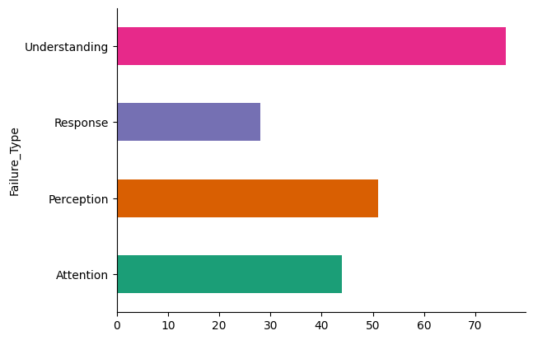
Result:
.
Fig. Failure_Type for voice assistance using gan

Slide 14
Reference:
https://keras.io/
https://numpy.org/
https://www.tensorflow.org/
https://www.kaggle.com/datasets/googleai/voice-assistant-failures?resource=download

Slide 15
Conclusion:
voice assistants represent a significant leap in human-computer interaction, offering users a convenient and natural way to interact with technology. With their ability to understand natural language commands, personalize responses, and integrate with various devices and services, voice assistants have become invaluable tools in enhancing productivity, accessibility, and convenience in users' daily lives. As these systems continue to evolve and improve, they hold the promise of revolutionizing how we interact with technology, making it more intuitive, efficient, and user-friendly for everyone.

Slide 16
Thank You
.

